Slide 1
Case Study: Roseau Historic District
Presented by : Annie Edwards (Mrs.)
Physical and Environmental Planner
Dominica

Slide 2
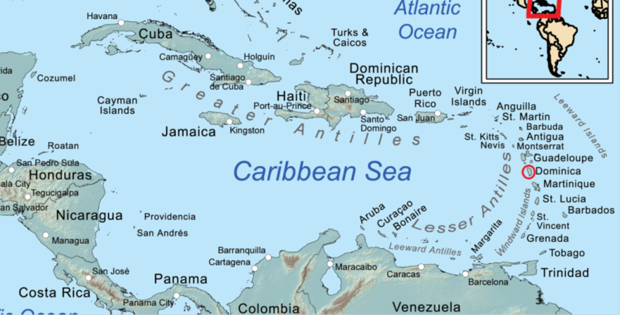
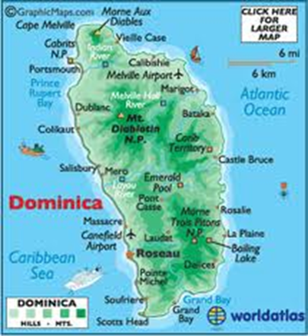
Dominica
Located at 61°25’ W longitude and 15° 25’ between
Area of 754 square kilometers (289.9 sq mls)
Largest English speaking island in the lesser Antilles
25 miles long and 16 miles wide
Population – 72,660

Slide 3
Dominica
Roseau is the capital city of Dominica;
Settled by the French in the early 1700s and then by the English in the late 1700s;
Changed hands many times in the subsequent century.

Slide 4
Legislative Framework for Roseau Historic District
Pursuant to Section 56 of the Physical Planning Act of (2002) the Authority may, and if so directed by the Minister shall, cause a survey to be made of the whole or any part of Dominica, either independently of or as part of a development plan made under Part III of this Act, with a view to determining whether any area of Dominica ought to be declared an environmental protection area.

Slide 5
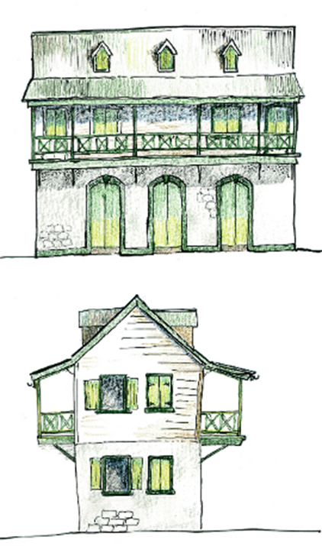
Roseau Historic District
Aim: To create a defined area within the city of Roseau that features historic buildings and general cultural interest.
The area selected is the French quarter and nine adjacent blocks to the west;
A large number of the French Vernacular and Colonial Architecture still exist;
There is a three tiered system in place for identifying historic buildings: Preservation (A), Rehabilitation (B), and New construction (C).

Slide 6
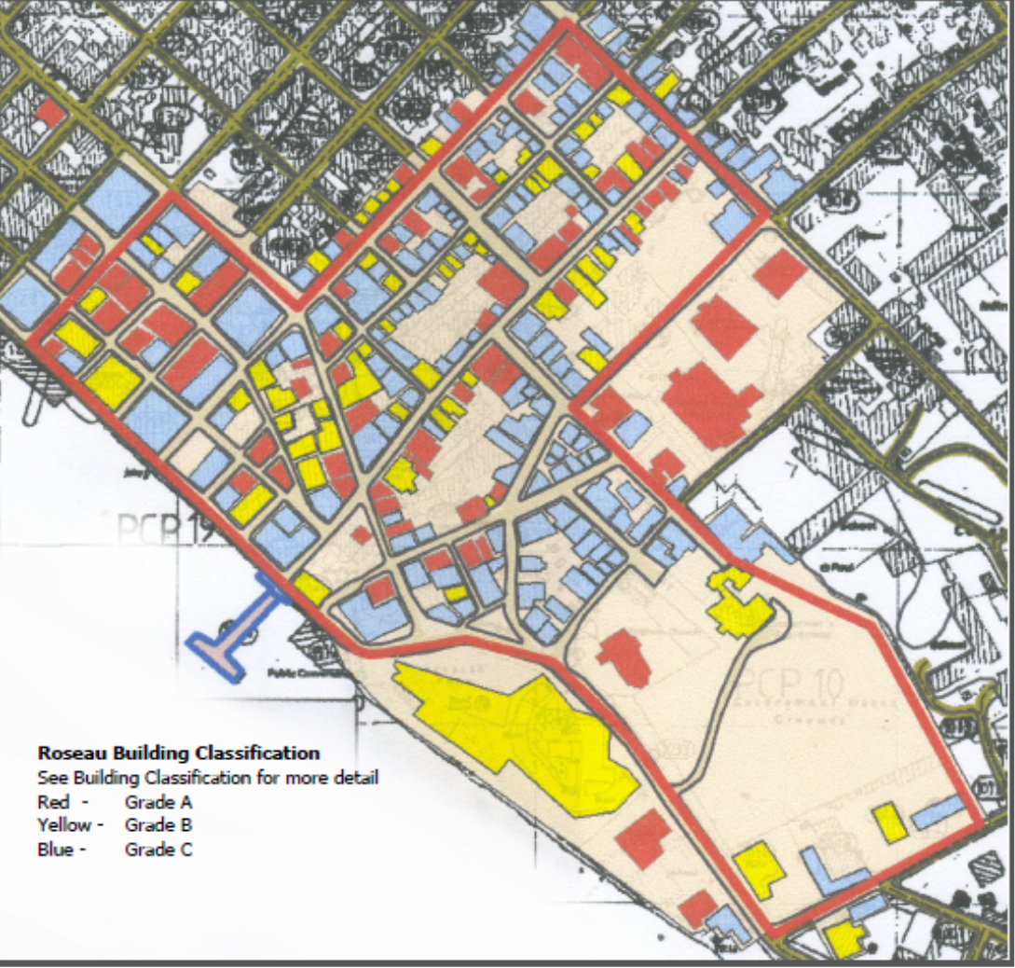
Roseau Historic District
Plans for the Roseau Historic District started in 2001
SHAPE (Society for Historical Architectural Preservation and Enhancement) was formed to promote awareness

Slide 7
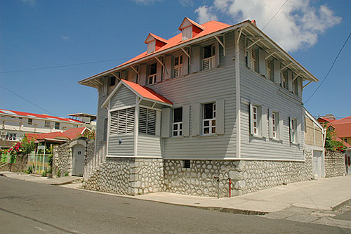
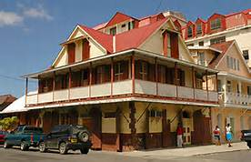
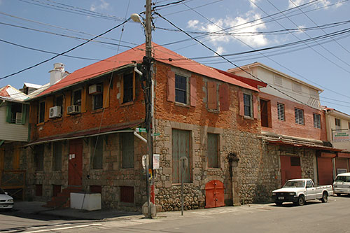
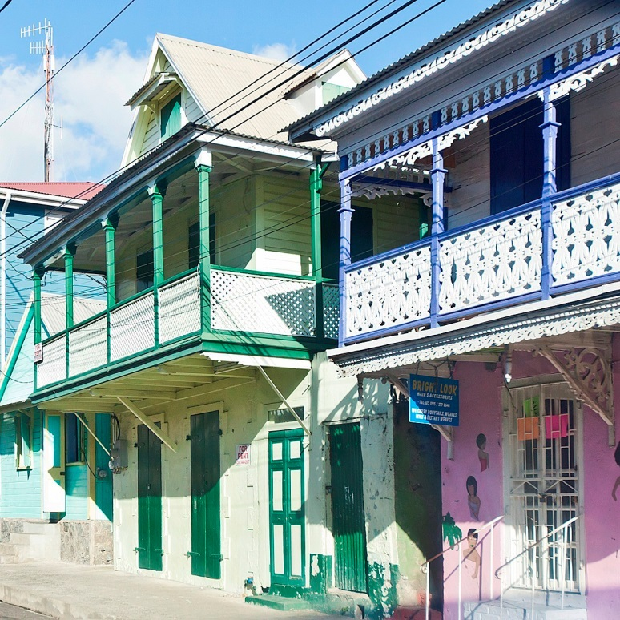
Historic buildings

Slide 8
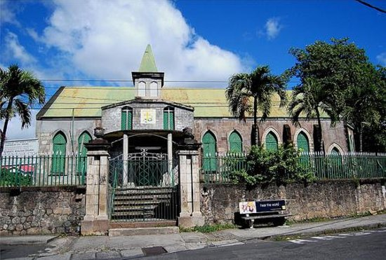
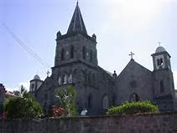
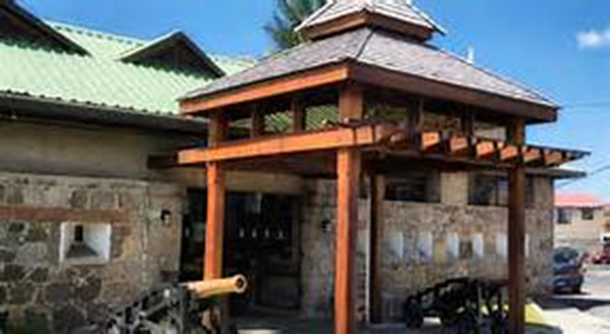
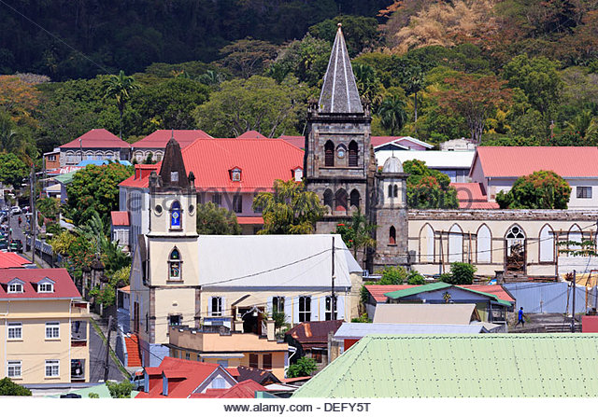

Slide 9
Old Market Square

Slide 10
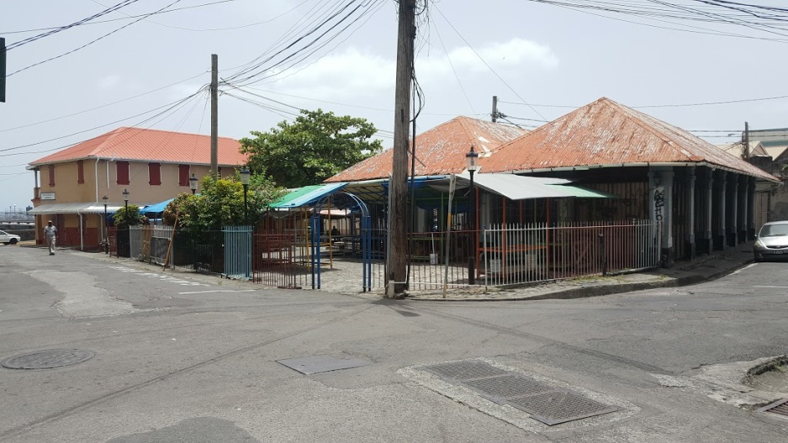
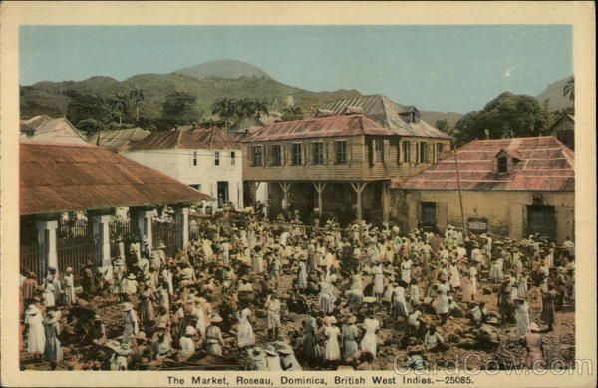
Old market then and now
In the days of slavery, this was a major market for the trading of slaves
Later it was the main market in the city

Slide 11
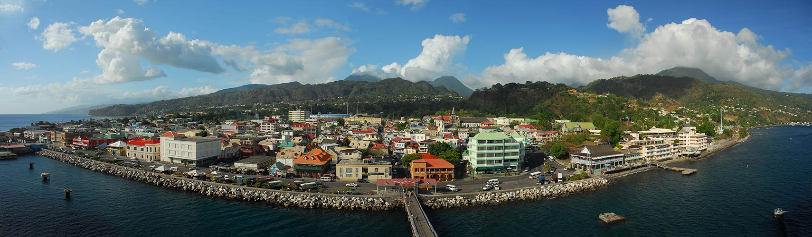
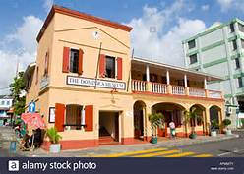
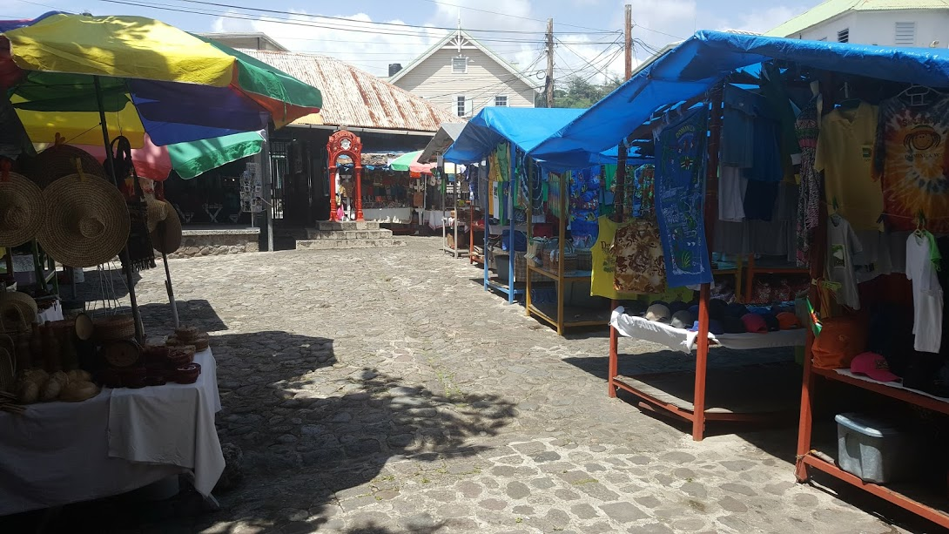
Potential of the Old Market Square
Panoramic view of Roseau
Museum
Museum
Cobblestone courtyard

Slide 12
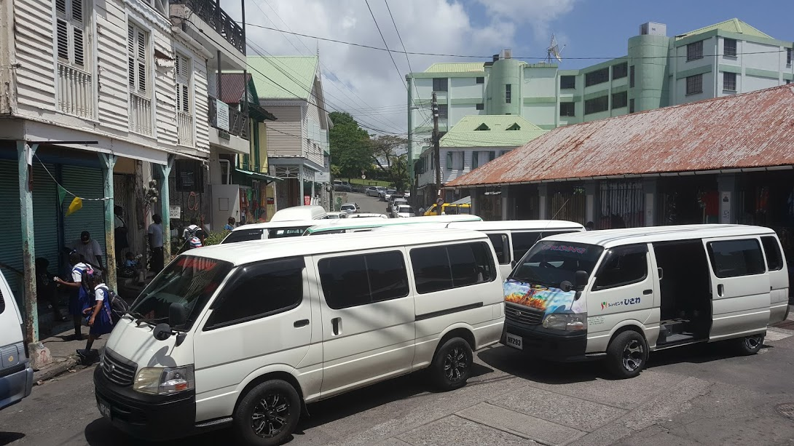
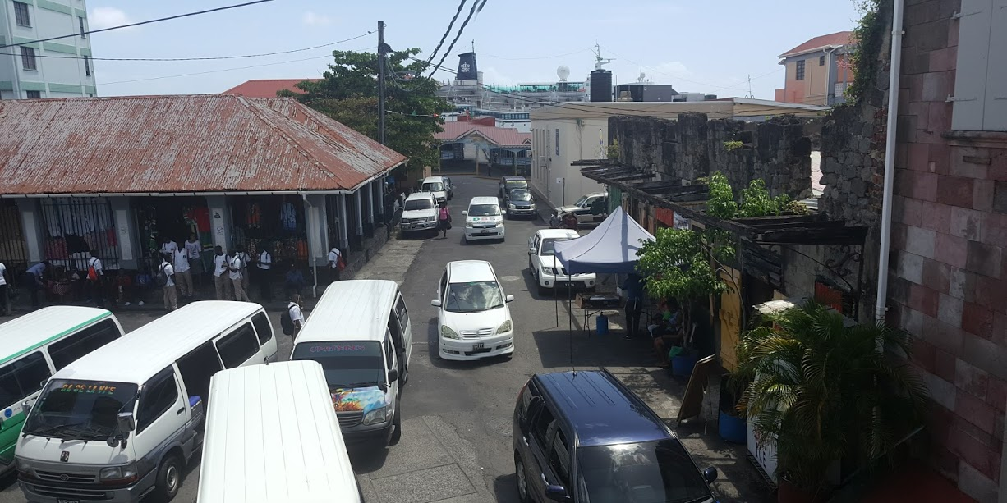
Issue: Bus stop; traffic congestions; cruise ship berth
Vending

Slide 13
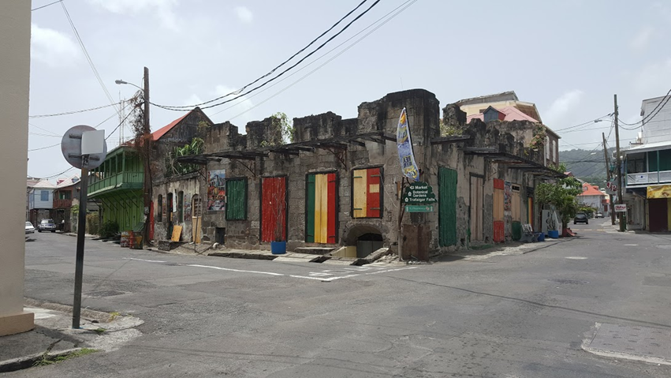
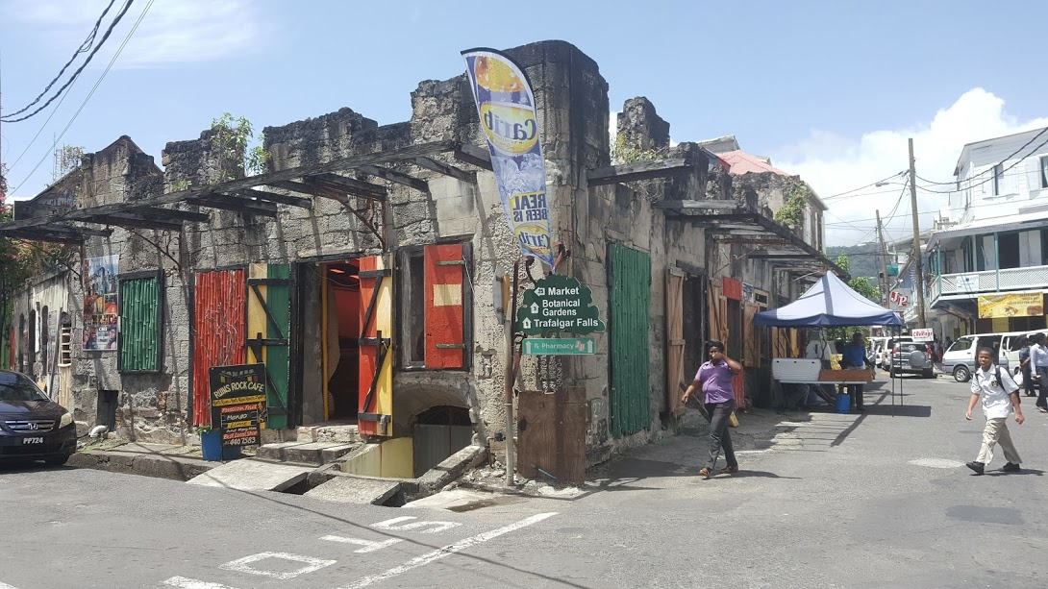
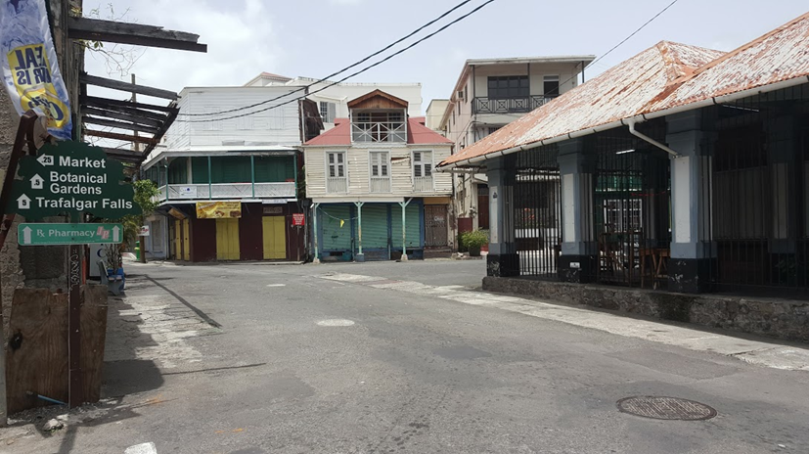
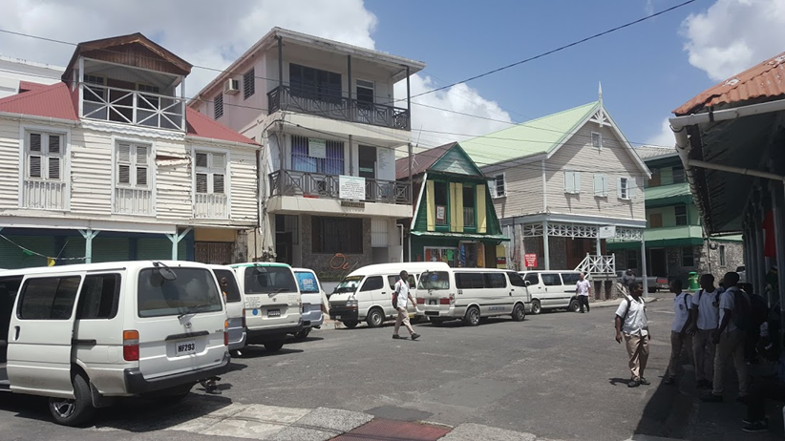
Issue: Urban decay

Slide 14
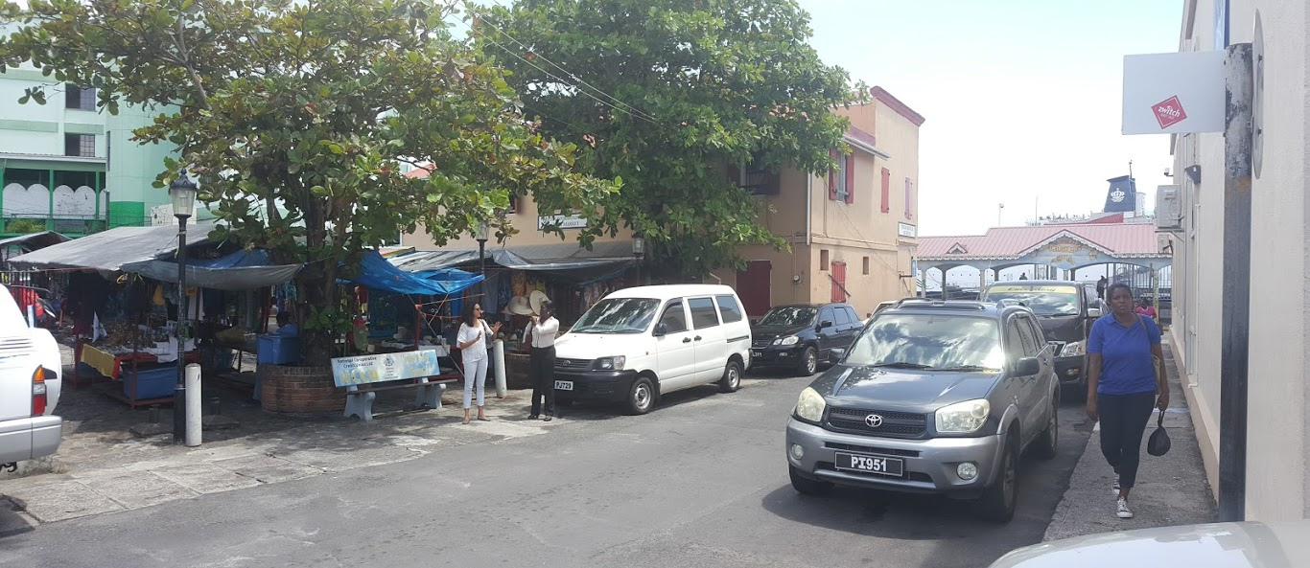
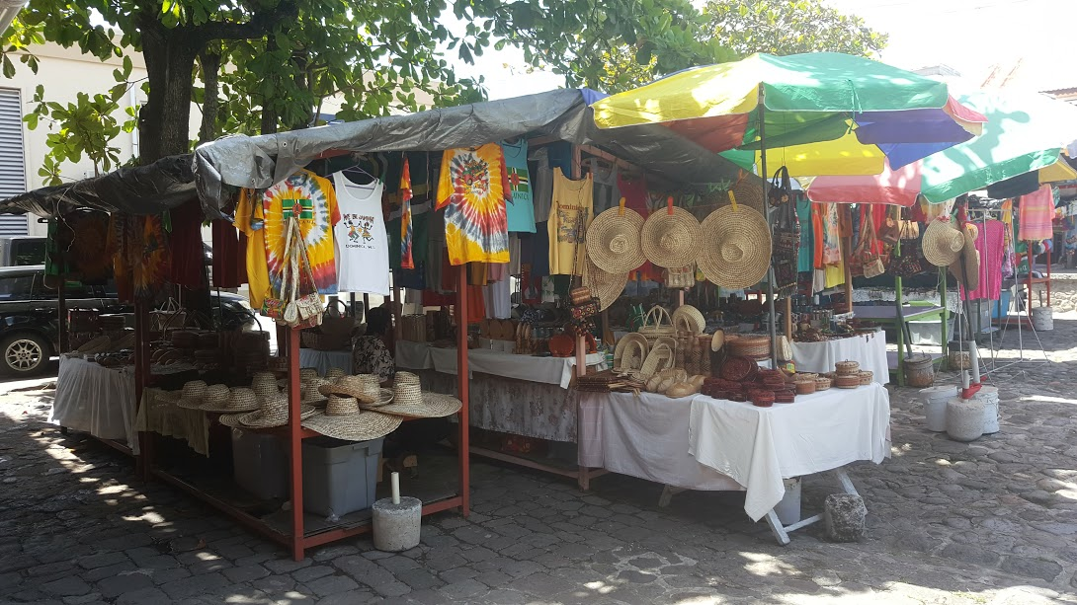
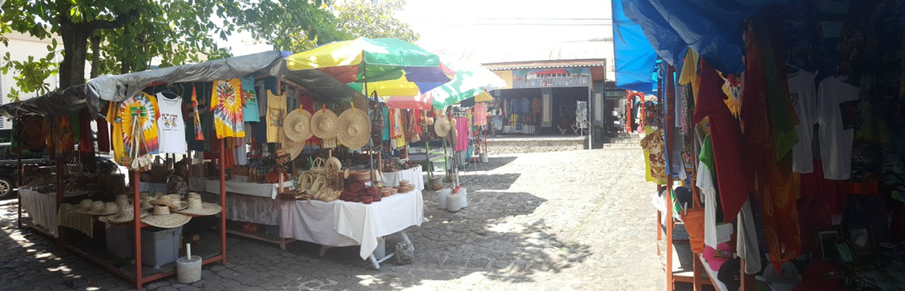
Issue: Disorganized Vending

Slide 15

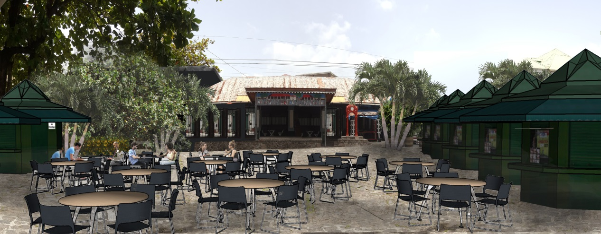
Proposed
Revitalization/Enhancement of inner market

Slide 16
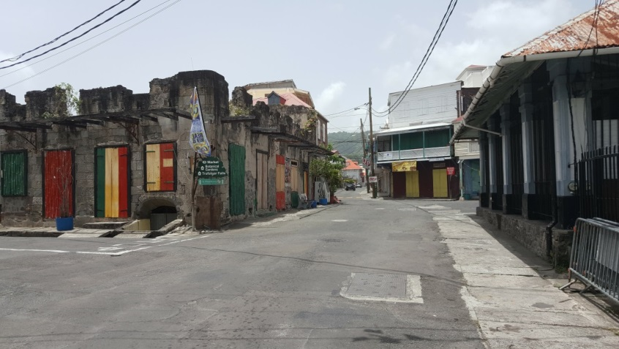
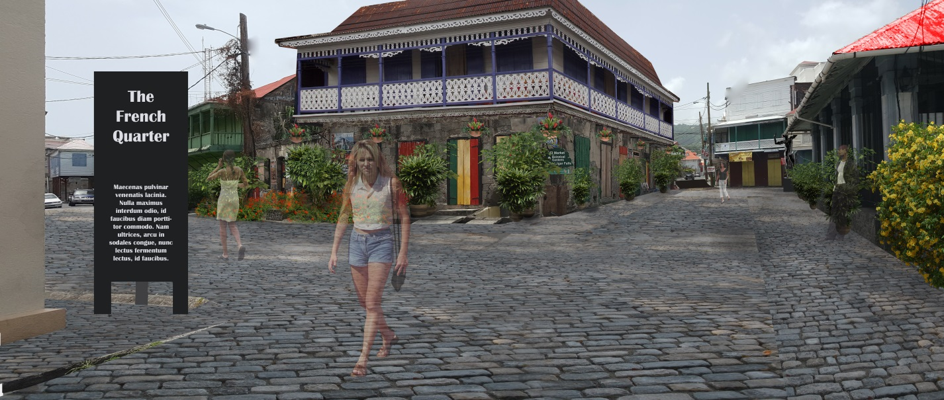
Old Market Square: Cobblestones will discourage vehicular traffic and encourage pedestrians

Slide 17
Other Proposals
A statue of a slave in the middle of the square where the bus stop exists;
Upgrade of all the facades along the square;
Planters along the entire square

Slide 18
Thank You

